Slide 1
5-100.urfu.ru
Comprehensive University
continuous transformation platform

Slide 2
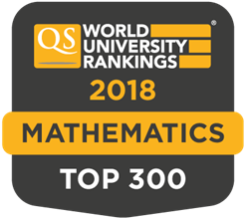
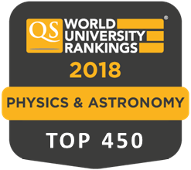
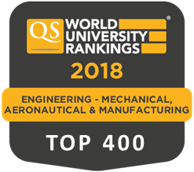
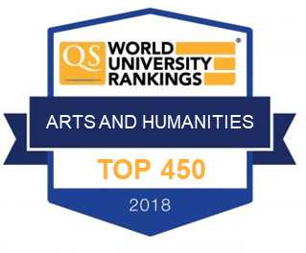
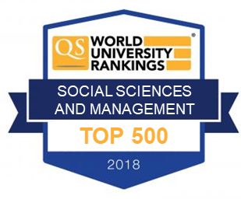
Successful integration of technical and classical universities
Change of the position in the QS World University ranking
412
№1 in the dynamics of growth in 2017-18
in QS World University Rankings among the universities of the "5-100“ project
№1 in mathematics
in QS by Subject among federal universities in Russia
2018
Ural State University
Ural Federal University
№1 among the Ural schools
in competitiveness of graduates of the specialized UrFU lyceum
2018
Metallurgical Engineering
TOP 200
Average score of the unified state examination (USE)
№2 in the number of enrolled students
In state-funded and contract programs in 2017 among the universities of Russia
75
74
72,5
65,7
2
2013
2014
2017
2018

Slide 3
Key figures of the University
as of 01.01.2018
Number of students, pers. 35 266
Bachelors 25 743
Masters and Specialists 8 478
PhD students 1 045
Foreign students, pers. 2 368
Number of employees*, pers. 8 682
Academic staff 3 193
Researchers 706
Foreign employees 224
Profile institutes, units 13
Departments, units 207
Laboratories, units 160
Buildings and constructions, structures 339
Total area of buildings, thousand m² 485
University budget for 2017, billion rubles 8,402
Amount of R&D in 2017, billion rubles 2,120
Competitive advantages of UrFU
Practice of cooperation with the leading enterprises of the region
Cooperation and "soft" integration with the academic institutions of FASO Russia
The combination of world-class technical and humanitarian competencies
Practice of project training
Investments in research and technology infrastructure
3
* Number of employees excluding rate shares, including external part-time employees

Slide 4
UrFU 2020+
UrFU 5–100 Program determines funding for the following areas
Self- transformation — shaping
a Comprehensive University
Combining technological and humanitarian
competencies to meet innovative challenges

Slide 5
+35%
>2600
Unique publications in
Web of Science and Scopus
In a year
In a year
Growth of R&D
the amount of work with the enterprises
Science Center
№3 in the absolute
volume of R&D for enterprises among the universities of the "5-100" project, according to the results of 2016
Indicator | 2014 | 2015 | 2016 | 2017
Volume of R&D, million rubles | 1138 | 1615 | 1830 | 2127
including through: Resolution № 218 | 110 | 154 | 181 | 199
Funds of enterprises and other projects | 390 | 472 | 778 | 1045
State order, grants of the RSF, RFBR, RHSF, the President and other FTPs | 540 | 625 | 481 | 401
Resolution № 220 | 19 | 12 | 21 | 0
Project 5-100 subsidy |  | 323 | 369 | 482
Forms and fulfills requests for innovation, personnel, research

Slide 6
Key areas
New production technologies
Sensorics
Robotics
Power Engineering
Intelligent power system management systems (Smart Grid)
Distributed and autonomous power engineering
Special impulse technology
Chemical Technologies and Materials for Nuclear Power Engineering
Neurotechnologies
Age-related and production neuropathologies
Devices for regenerative medicine
Virtual and Augmented Reality System for training
Complex program "Smart Region"
«Smart» mobility
«Smart» management
«Smart» environment
New materials
New construction materials for extreme conditions
Prospective magnetic materials
The world-class science and education center
Laser and additive technologies
Recycling of technical and household waste
Engine building
Key Russian partners of UrFU involved in the development of advanced technologies:
Pipe Metallurgical Company
Sinara Group
Scientific and Production Association of Automation named after Academician N.A. Semihatov
United Heavy Machinery
Uranium Holding “ARMZ”
Rosatom
Ural Mining and Metallurgical Company
Concern “Almaz-Antey”
Gazprom
Concern "Radioelectronic Technologies“
Ural industrial enterprise "Vector“
Russian Networks, System Operator of the Unified Energy System
SKB Kontur
Ministry of Emergency Situations (Russia)
Ural Center for Reanimation Neurorehabilitation "Clinical Institute of the Brain"
“Smart” Materials
Prosepctive organic materials for medical equipment
«Smart» economy
«Smart» lifestyle
6

Slide 7
Main directions of investments in development in 2017-18
Direction of investments in development | Amount of investments | Source of financing
Cyclotron center of nuclear medicine | 160 – 180 million rubles per year | Extrabudgetary funds from educational activities
Stimulation of the publication activity and priority activities of the Scientific and Educational Workers (rating) | > 100 million rubles per year | Extrabudgetary funds and education subsidy
Support of priority research projects, competence centers and other activities aimed at the competitiveness enhancement | 470 – 480 million rubles per year | 5-100 Subsidy
Foundation for Development of Priority Educational Programs | 30 million rubles per year | Education subsidy
Current level of annual expenditure on the development of UrFU
< 800 million rubles
7

Slide 8
UrFU, Ekaterinburg
A world-class university in the heart of Eurasia
Contact us
Office of International Research Projects Anna Boikova boikova.anna@urfu.ru
+7 912 246 0408
Svetlana Timofeeva
svetlana.timofeeva@urfu.ru
+7 909 173 6610
Comprehensive University
8

